Slide 1
Impact of Weather & Community Disorder on Crime in Calgary
DATA 601: PRESENTATION
BY
Joshua Ogunbo
Ravin Jayasuriya
Prince Oloma
13TH FEBRUARY 2025

Slide 2
INTRODUCTION
This study examines the relationship between crime rates, community disorder and weather patterns across Calgary’s wards. By analyzing historical crime data alongside weather data, the study aims to determine whether weather conditions influence fluctuations in crime rates.
Understanding this relationship will provide valuable insights for policymakers, law enforcement agencies, and community stakeholders. This will enable the development of data-driven strategies for crime prevention and enhanced public safety.

Slide 3
GUIDING QUESTIONS
What are the types and count of crimes that occurred in the last 5 years?
Which are the top 5 recurring crimes for each season in the last 5 years?
Which ward has the most crime rate in the last 5 years?
Is there a relationship between crime count and community disorder count?

Slide 4
PACKAGES
1. Pandas
The Pandas Python library has been imported in order to easily manipulate numerical tables and time series data. It has enabled the team to read the dataset into the Jupyter Notebook.
2. Matplotlib
This Python library has been imported in order to create easy-to-read visualizations, including various plots such as Bar charts, Line Graph Series, Heat Maps e.t.c. and also add customizations to styles and layouts of the visualizations.
3. Seaborn
The Seaborn Python data visualization library has been imported to provide high-level and informative statistical graphics to capture the data story-telling aspect of the project and to create visualizations such as: bar charts, Heat Maps.
4. Geopandas
The geopandas library in Python is used for working with geospatial data. It extends the capabilities of pandas to handle spatial data types like points, lines, and polygons, making it easier to perform spatial operations and analysis. We used this library for plotting our HeatMaps showing geographical information of crime frequencies by ward.

Slide 5
DATASETS
DATASET NAME | DESCRIPTION | NUMBER OF ROWS AND COLUMNS | DATA COLLECTION PERIOD
Community Crime Startistics | It contains columns: community name, crime category, crime count, year and month of occurence. | Rows - 77,100 Columns - 5 | 2018 - 2025
Communities By Ward | It contains columns: community code, name, class, ward number, sector, SRG, ward and community structure. | Rows - 312 Columns - 8 | 2014
ACIS Monthly Weather Data - Calgary Int’l CS --- Calgary Weather Data | It contains station name, air temp (celsius), air temp Avg. source flag, air temp Avg. Record Completeness, air temp Average comment. | 1st Dataset - 50 & 6 2nd Dataset - 26 & 6 | 2018 - 2022 2022 - 2014
Community Disorder Statistics Calgary | It contains community name, category, event count, year and month. | Rows - 21,445 Columns - 5 | 2018 - 2024

Slide 6
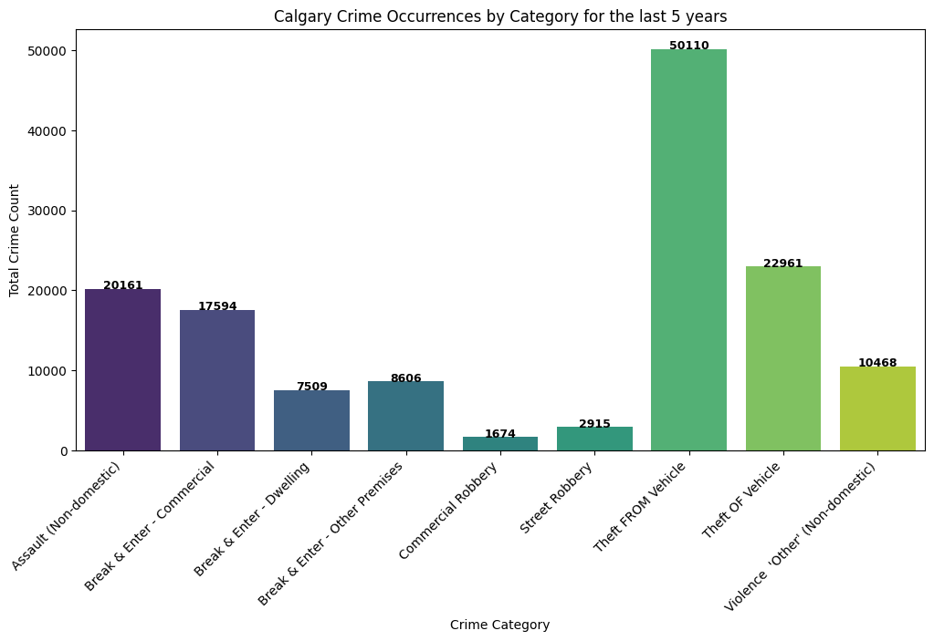
GUIDING QUESTION I
What are the types and count of crimes that occurred in the last 5 years?

Slide 7
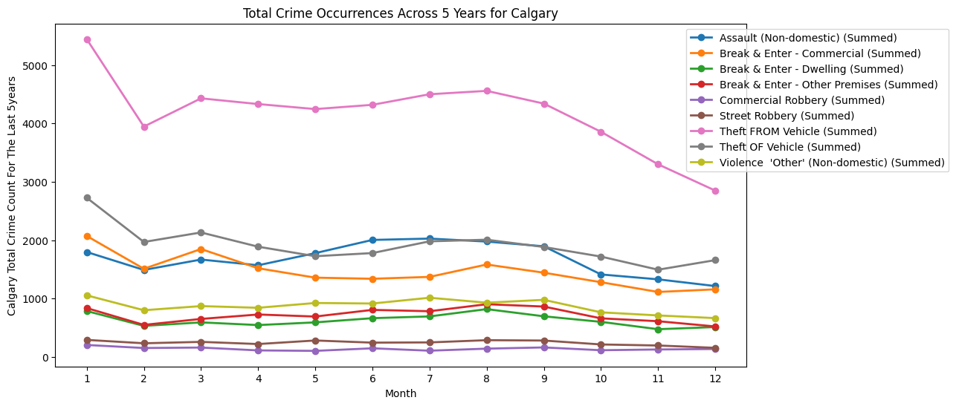
GUIDING QUESTION I

Slide 8
ANALYSIS I

Slide 9
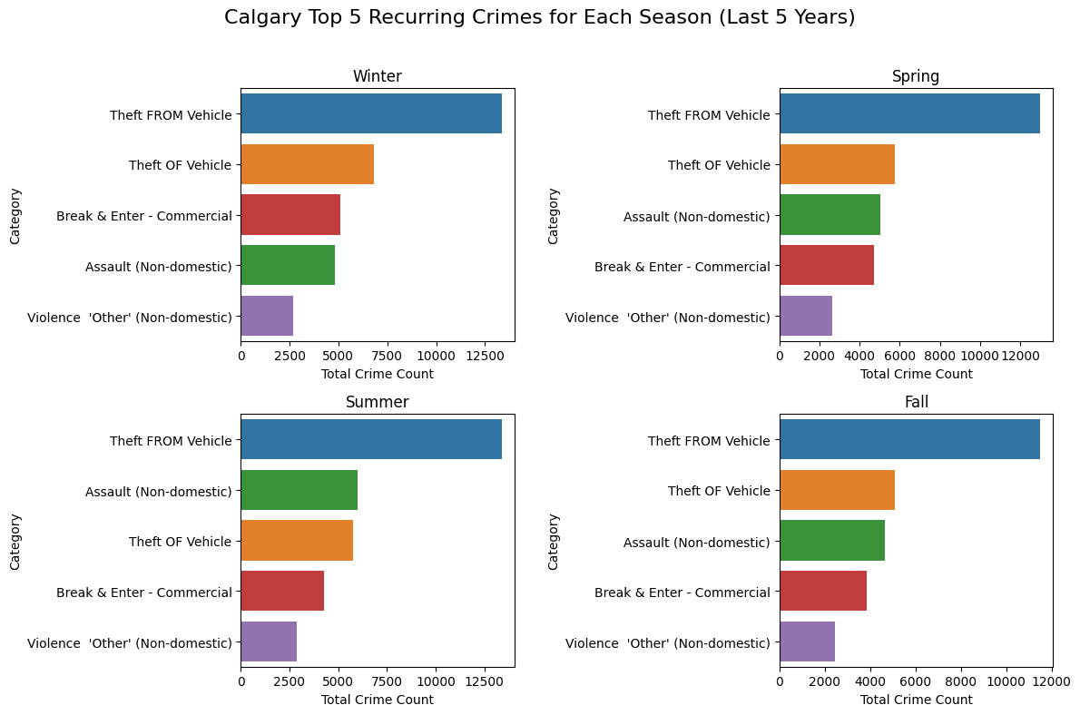
GUIDING QUESTION II
Which are the top 5 recurring crimes for each season in the last 5 years?

Slide 10
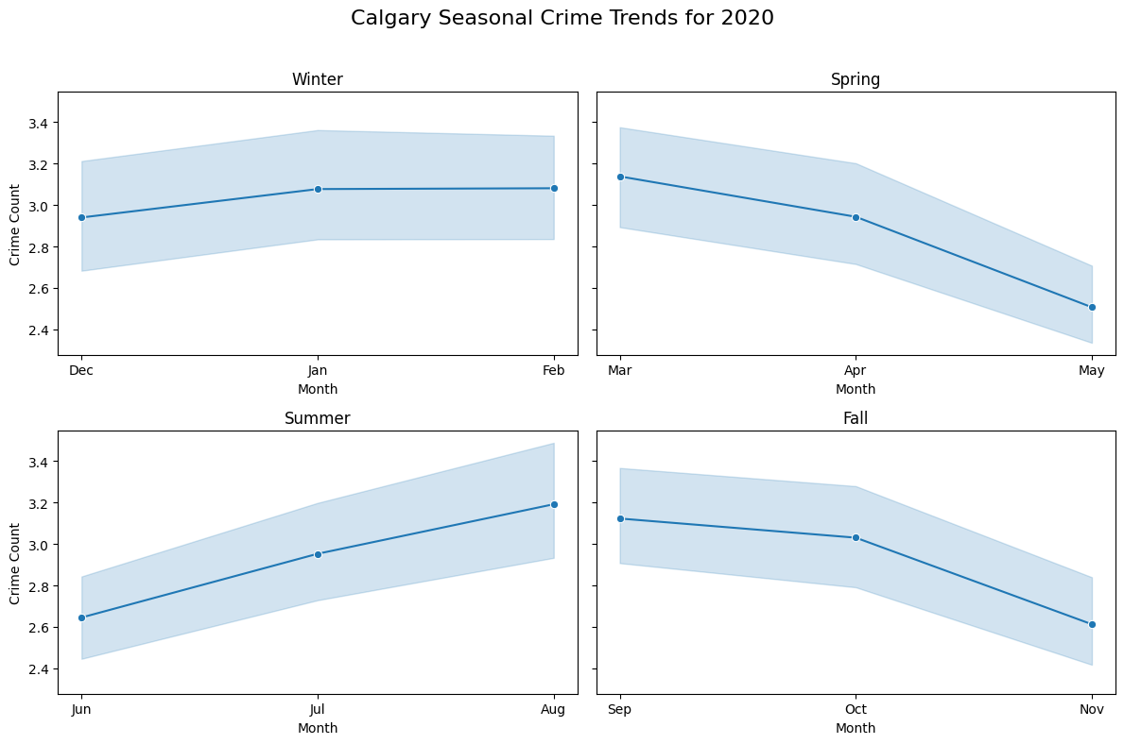
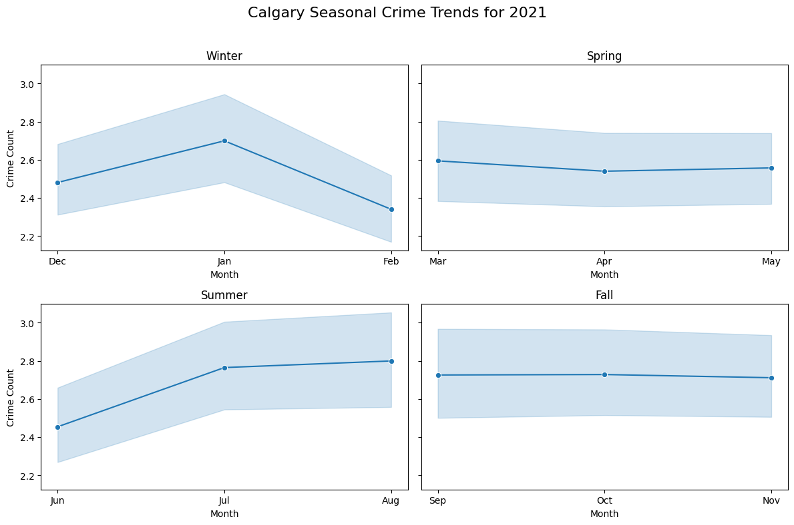
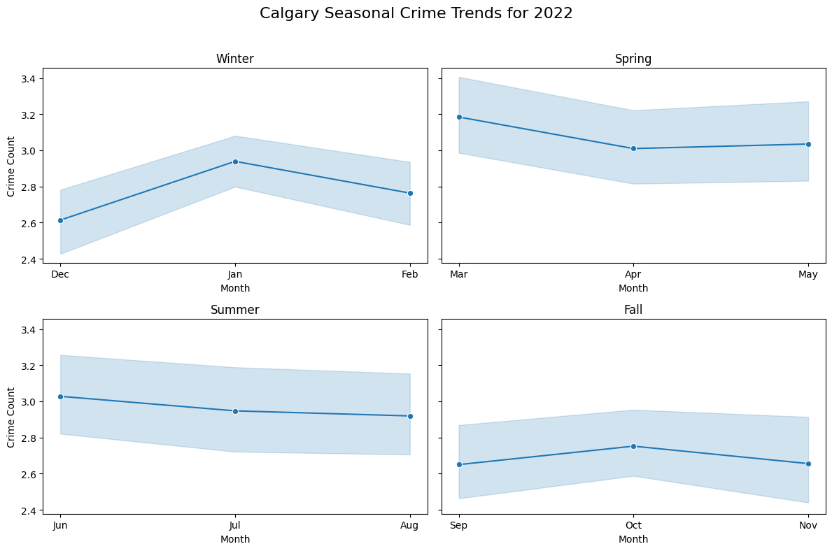
GUIDING QUESTION II

Slide 11
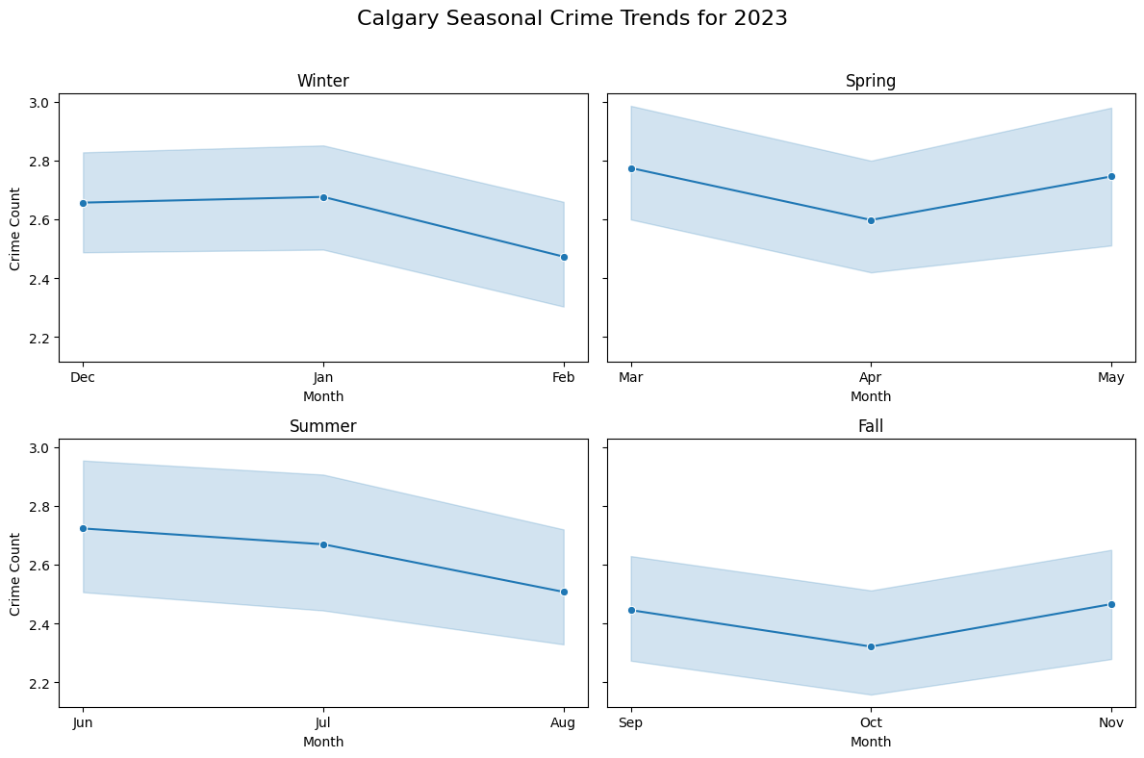
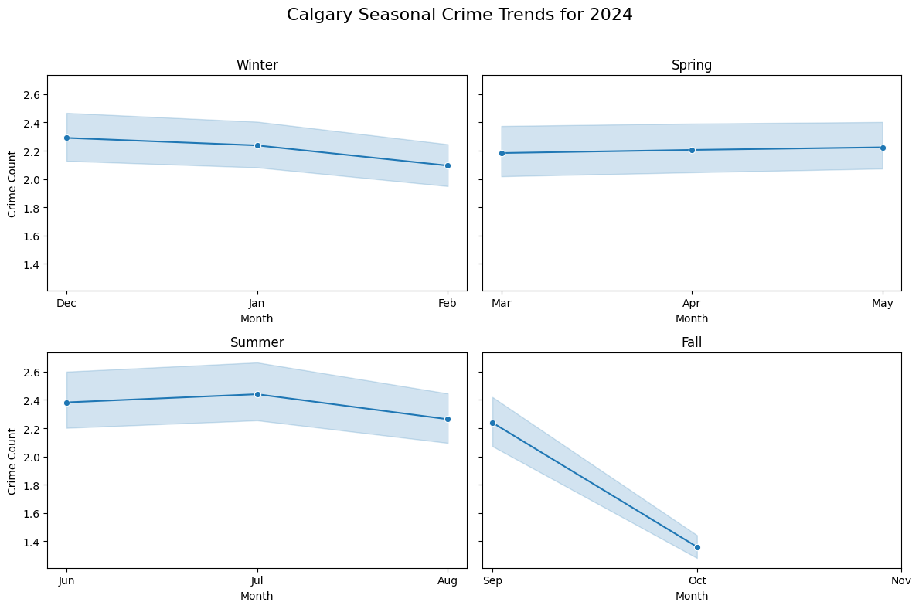
GUIDING QUESTION II

Slide 12
ANALYSIS

Slide 13
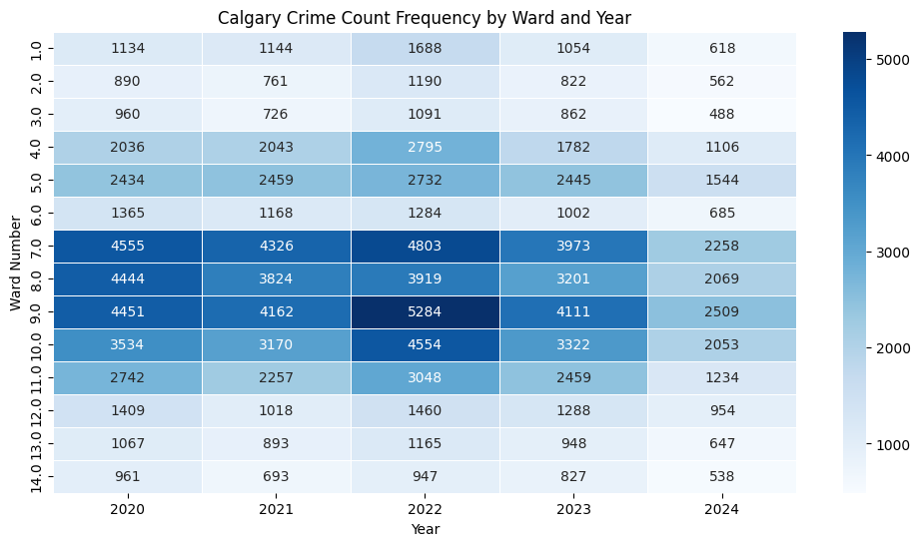
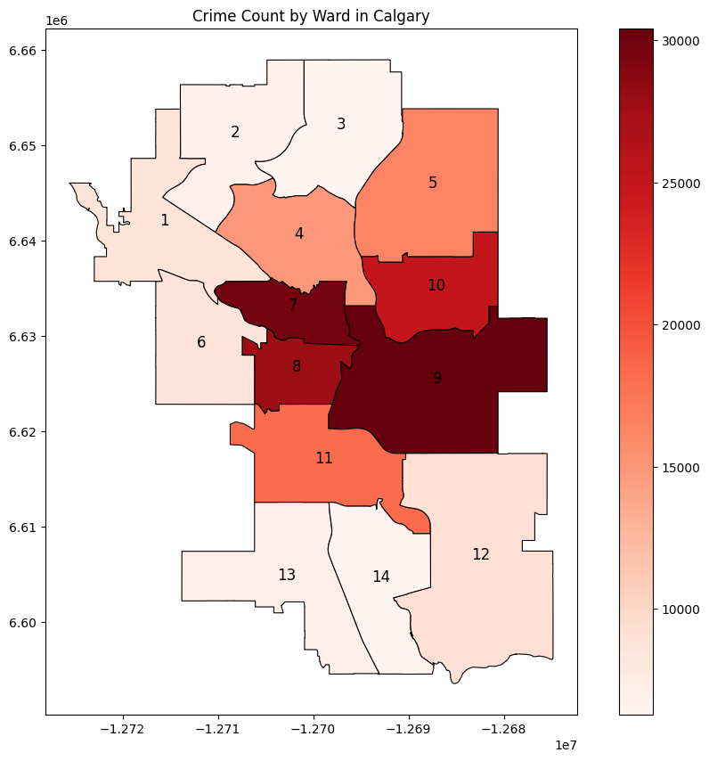
GUIDING QUESTION III
Which ward has the most crime rate in the last 5 years?

Slide 14
ANALYSIS

Slide 15
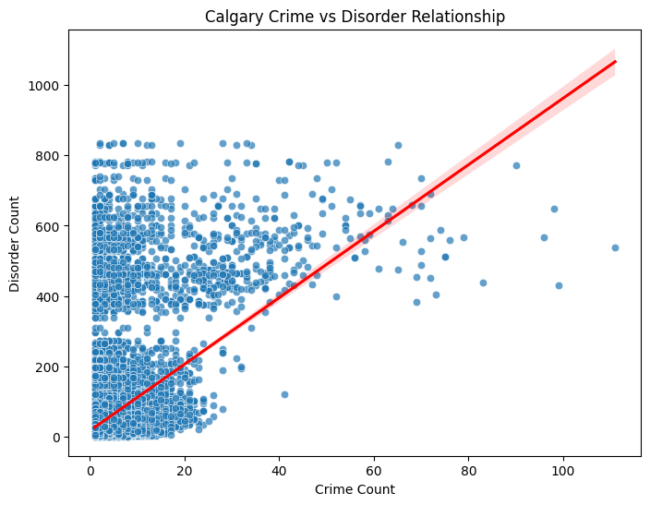
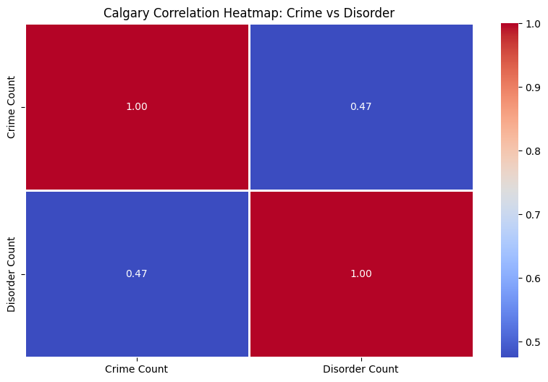
GUIDING QUESTION IV
Is there a relationship between crime count and community disorder count?

Slide 16
ANALYSIS

Slide 17
CONCLUSION

Slide 18
REFERENCES
City of Calgary. (Feb 5 2020). Community Crime Statistics. Retrieved January 19, 2025, from https://data.calgary.ca/Health-and-Safety/Community-Crime-Statistics/78gh-n26t/about_data
City of Calgary. (March 14 2017). Communities by Ward. Retrieved January 19, 2025, from https://data.calgary.ca/Government/Communities-by-Ward/jd78-wxjp/about_data
Alberta Climate Information Service (ACIS). (2018). Monthly Weather Data. Retrieved January 19, 2025, from https://acis.alberta.ca/weather-data-viewer.jsp
Calgary Disorder Data – https://data.calgary.ca/Health-and-Safety/Community-Disorder-Statistics/h3h6-kgme/about_data
Data 602 lecture notes -- Syyed Tauhid Ullah Shah https://github.com/SyedTauhidUllahShah/DATA601W25

